Slide 1
Reducing Leximin Fairness to Utilitarian Optimization
"If your brother becomes poor and cannot maintain himself with you, you shall support though he were a stranger and a sojourner, so that he shall live with you." (Leviticus 25)
Accepted to AAAI’25 ☺
Eden Hartman, Yonatan Aumann, Avinatan Hassidim, Erel Segal-HaLevi

Slide 2
Candidate outcomes (selections)
Social Choice
Selection
Agents’ preferences
over selections

Slide 3
Candidate outcomes (selections)
Welfarist
Social Choice
Selection that
optimizes a welfare objective
Agents’ utility functions
over selections

Slide 4
Welfare objectives
Maximize the sum of agents’ utilities.
Utilitarian
Maximize the sum of agents’ utilities.
Egalitarian
Maximize the minimum utility.
Leximin
Maximize the minimum utility.
subject to this, maximize second-smallest utility;
subject to this, maximize third-smallest utility;
and so on.

Slide 5
Welfare objectives – Computation
Maximize the sum of agents’ utilities.
Utilitarian
Maximize the sum of agents’ utilities.
Egalitarian
Maximize the minimum utility.
Leximin
Maximize the minimum utility.
subject to this, maximize second-smallest utility;
subject to this, maximize third-smallest utility;
and so on.

Slide 6
Welfare objectives – Complexity
Example: Allocating Indivisible Goods Among Agents With Additive Utilities
Utilitarian
Poly: greedily assign each item to the agent who values it most.
Egalitarian
NP-hard Approximation algorithms exist (e.g. Bansal and Sviridenko, 2006).
Leximin
⇒ NP-hard.
We are not aware of any approximation algorithms.
The Santa Claus problem. Bansal and Sviridenko, 2006.

Slide 7
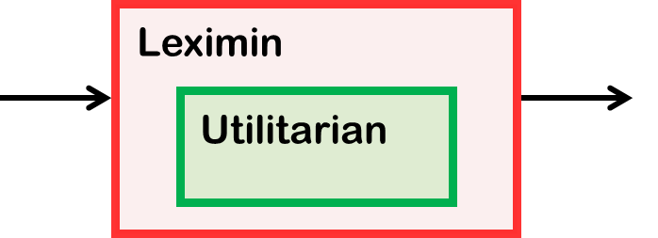
Our Contribution
For any social choice problem with utilities $≥0$:
If you give us a black-box that computes a utilitarian-optimal¹ selection in polytime –
then we give you a polytime algorithm that computes a leximin-optimal (in expectation) lottery over selections.
Our reduction is robust:
If your black-box is 𝛼-approximately utilitarian-optimal -
then our lottery is 𝛼-approximately leximin-optimal².
1. for weighted (non-normalized) utilities.
2. for an appropriate definition of ‘approximately leximin-optimal’.

Slide 8
Previous Work (Kawase & Sumita, 2020)
Problem
Stochastic Allocation of Indivisible Goods.
The output is a lottery over the set of (deterministic) allocations.
Theorem: Given an 𝛼-approx. alg. for utilitarian
one can obtain an 𝛼-approx. alg. for egalitarian in polynomial time.
Egalitarian
Utilitarian
On the Max-Min Fair Stochastic Allocation of Indivisible Goods. Kawase and Sumita, 2020.

Slide 9
Our Work (2024)
Problem
Any social choice problem with utilities $≥0$.
The output is a lottery over the set of (deterministic) selections.
Theorem: Given an 𝛼-approx. alg. for utilitarian
one can obtain an 𝛼-approx. alg. for leximin in polynomial time.
Leximin
Utilitarian

Slide 10
Our Work (2024)
Problem
Any social choice problem with utilities $≥0$.
The output is a lottery over the set of (deterministic) selections.
Theorem: Given an 𝛼-approx. alg. for utilitarian
one can obtain an 𝛼-approx. alg. for leximin in polynomial time.
Applications
Stochastic Indivisible Allocation¹
Additive utilities $⇒$ Exact
Submodular utilities $⇒$ $0.5$-approx (det)
Submodular utilities $⇒$ $\left(1−\frac{1}{e}\right)$-approx (rand)
Participatory Budgeting Lottery²
An FPTAS for leximin
Giveaway Lotteries³
An FPTAS for leximin
On the Max-Min Fair Stochastic Allocation of Indivisible Goods. Kawase and Sumita, 2020.
Fair Lotteries for Participatory Budgeting. Aziz, Lu, Suzuki, Vollen, and Walsh, 2024.
Fair and Truthful Giveaway Lotteries. Arbiv and Aumann, 2022.

Slide 11
The Model
Agents
$$N=\left\{1, …, n\right\}$$
Selections
$S=\{ s_{1}, …, s_{\left|S\right|} \}$
(deterministic outcomes)
Solutions
A solution is a distribution over selections.
$$X=\left\{x=\left(x_{1}, …, x_{|S|}\right)∈\left.ℝ_{≥0}^{|S|} \right| \sum_{j=1}^{|S|}{x_{j}}=1\right\}$$
Utilities
(a value oracle)
$u_{i} :S→ℝ_{≥0}$ $∀i∈N$
Expected
Utilities
$E_{i} :X→ℝ_{≥0}$ $∀i∈N$
$$E_{i}\left(x\right)=\sum_{j=1}^{|S|}{x_{j}}⋅u_{i}(s_{j})$$
Notes:
as there always exists a deterministic solution (a single selection) that maximizes the utilitarian welfare.

Slide 12
The Model
Utilitarian Opt.
Agents
$$N=\left\{1, …, n\right\}$$
A solution $x^{uo}∈X$ s.t $∀x∈X :$
$$\sum_{i=1}^{|S|}{E_{i}({x^{uo})}_{ }≥}\sum_{i=1}^{|S|}{E_{i}({x)}_{ }}$$
Selections
$S=\{ s_{1}, …, s_{\left|S\right|} \}$
(deterministic outcomes)
Solutions
A solution is a distribution over selections.
$$X=\left\{x=\left(x_{1}, …, x_{|S|}\right)∈\left.ℝ_{≥0}^{|S|} \right| \sum_{j=1}^{|S|}{x_{j}}=1\right\}$$
Utilities
(a value oracle)
$u_{i} :S→ℝ_{≥0}$ $∀i∈N$
Expected
Utilities
$E_{i} :X→ℝ_{≥0}$ $∀i∈N$
$$E_{i}\left(x\right)=\sum_{j=1}^{|S|}{x_{j}}⋅u_{i}(s_{j})$$
Notes:
as there always exists a deterministic solution (a single selection) that maximizes the utilitarian welfare.

Slide 13
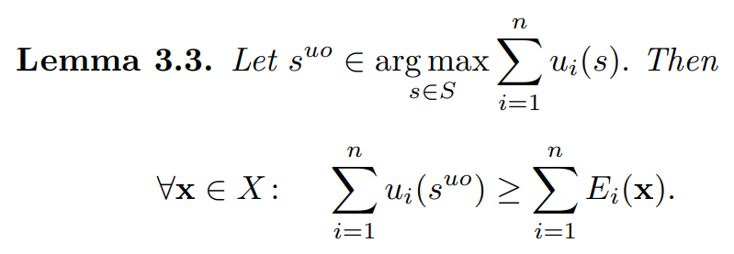
The Model
Utilitarian Opt.
Agents
$$N=\left\{1, …, n\right\}$$
A solution $x^{uo}∈X$ s.t $∀x∈X :$
$$\sum_{i=1}^{|S|}{E_{i}({x^{uo})}_{ }≥}\sum_{i=1}^{|S|}{E_{i}({x)}_{ }}$$
Selections
$S=\{ s_{1}, …, s_{\left|S\right|} \}$
(deterministic outcomes)
Solutions
A solution is a distribution over selections.
$$X=\left\{x=\left(x_{1}, …, x_{|S|}\right)∈\left.ℝ_{≥0}^{|S|} \right| \sum_{j=1}^{|S|}{x_{j}}=1\right\}$$
Stochasticity is Unnecessary for Utilitarian
Utilities
(a value oracle)
$u_{i} :S→ℝ_{≥0}$ $∀i∈N$
Expected
Utilities
$E_{i} :X→ℝ_{≥0}$ $∀i∈N$
$$E_{i}\left(x\right)=\sum_{j=1}^{|S|}{x_{j}}⋅u_{i}(s_{j})$$
Notes:
as there always exists a deterministic solution (a single selection) that maximizes the utilitarian welfare.

Slide 14
The Model
Weighted Utilitarian Opt.
Given $n$ constants $c_{1},…,c_{n} ≥0$ .
A solution $x^{uo}∈X$ s.t $∀x∈X :$
$$\sum_{i=1}^{|S|}{c_{i}⋅E_{i}({x^{uo})}_{ }≥}\sum_{i=1}^{|S|}{{c_{i}⋅E}_{i}({x)}_{ }}$$
Agents
$$N=\left\{1, …, n\right\}$$
Selections
$S=\{ s_{1}, …, s_{\left|S\right|} \}$
(deterministic outcomes)
Solutions
A solution is a distribution over selections.
$$X=\left\{x=\left(x_{1}, …, x_{|S|}\right)∈\left.ℝ_{≥0}^{|S|} \right| \sum_{j=1}^{|S|}{x_{j}}=1\right\}$$
Utilities
(a value oracle)
$u_{i} :S→ℝ_{≥0}$ $∀i∈N$
Expected
Utilities
$E_{i} :X→ℝ_{≥0}$ $∀i∈N$
$$E_{i}\left(x\right)=\sum_{j=1}^{|S|}{x_{j}}⋅u_{i}(s_{j})$$
Notes:
as there always exists a deterministic solution (a single selection) that maximizes the utilitarian welfare.

Slide 15
The Model
Leximin Opt.
Agents
$$N=\left\{1, …, n\right\}$$
A solution $x^{∗}∈X$ s.t $∀x∈X :$
$$\left(E_{1}\left(x^{∗}\right), …, E_{n}\left(x^{∗}\right)\right)≽\left(E_{1}\left(x^{ }\right), …, E_{n}\left(x^{ }\right)\right)$$
Selections
$S=\{ s_{1}, …, s_{\left|S\right|} \}$
(deterministic outcomes)
Solutions
A solution is a distribution over selections.
$$v^{↑}$$
$v$ sorted in
weakly-increasing order
$$X=\left\{x=\left(x_{1}, …, x_{|S|}\right)∈\left.ℝ_{≥0}^{|S|} \right| \sum_{j=1}^{|S|}{x_{j}}=1\right\}$$
Leximin order
$v≽u$
if (1) $v^{↑}=u^{↑}$
or (2) $∃ 1≤k≤n$ s.t
Utilities
(a value oracle)
(2.1) $v_{i}^{↑}=u_{i}^{↑}$. for $i<k$
(2.2) $v_{k}^{↑}>u_{k}^{↑}$
$u_{i} :S→ℝ_{≥0}$ $∀i∈N$
Expected
Utilities
$E_{i} :X→ℝ_{≥0}$ $∀i∈N$
$$E_{i}\left(x\right)=\sum_{j=1}^{|S|}{x_{j}}⋅u_{i}(s_{j})$$

Slide 16
Leximin Optimization
Leximin is a multi-objective problem.
Algorithms are usually:
Iterative, solve one program in each iteration
Each iteration uses the opt. values from previous iterations as constants.
Leximin
Solver
Solver

Slide 17
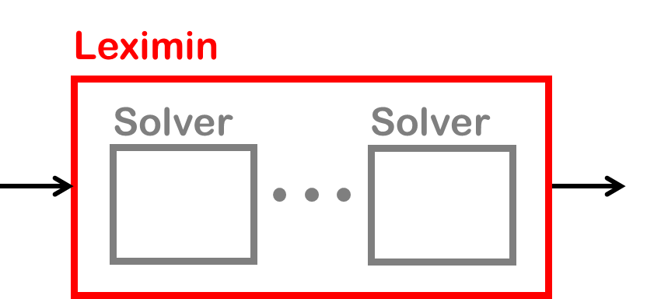
Leximin Optimization
Leximin is a multi-objective problem.
Algorithms are usually:
Iterative, solve one program in each iteration
Each iteration uses the opt. values from previous iteration as constants.

Slide 18
Leximin Optimization
Leximin is a multi-objective problem.
Algorithms are usually:
Iterative, solve one program in each iteration
When $t=1$, solve egalitarian:
Each iteration uses the opt. values from previous iteration as constants.
$$E_{i}^{↑}(x)$$
The $i$-th smallest
expected-utility obtained by $x$
$max ⁡{ E}_{1}^{↑}(x)$
$s.t. x∈X$

Slide 19
Leximin Optimization
Leximin is a multi-objective problem.
Algorithms are usually:
Iterative, solve one program in each iteration
When $t=1$, solve egalitarian:
Each iteration uses the opt. values from previous iteration as constants.
$max⁡ z$
$s.t. \left(1\right) x∈X$
$\left(2\right) E_{i}\left(x\right)≥ z ∀ i = 1, …, n$

Slide 20
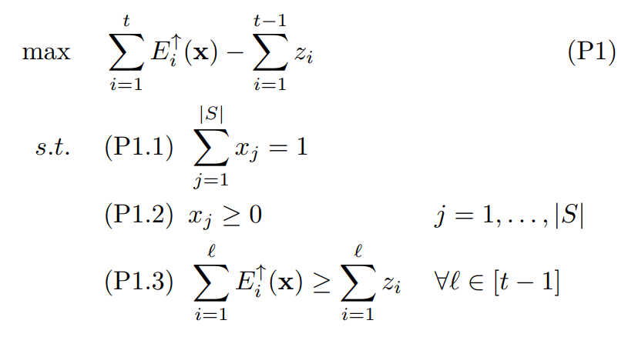
The Ordered Outcomes Algorithm (Ogryczak & Sliwinski, 2006)
For t = 1, … n:
Solve:
Let $x^{t}$ be the solution, and $z^{t}$ be its objective value.
Return $x^{n}$
$$E_{i}^{↑}(x)$$
The $i$-th smallest
expected-utility at solution $x$
On Direct Methods for Lexicographic Min-Max Optimization. Ogryczak and Sliwinski, 2006.
Notes:
Theorem 1 in (Ogryczak & Sliwinski)

Slide 21
The Ordered Outcomes Algorithm
For t = 1, … n:
Solve:
Let $x^{t}$ be the solution, and $z^{t}$ be its objective value.
Return $x^{n}$
Theorem (Ogryczak & Sliwinski):
Given an exact solver for P1,
the alg. output is leximin-optimal.
In some situations,
solving P1 exactly is NP-hard
(even for $t=1$)
E.g., stochastic allocation
of indivisible goods among agents
with submodular utilities
Theorem (Kawase & Sumita 2020):
Optimal Egalitarian is NP-hard.
On Direct Methods for Lexicographic Min-Max Optimization. Ogryczak and Sliwinski, 2006.
On the Max-Min Fair Stochastic Allocation of Indivisible Goods. Kawase and Sumita, 2020.
Notes:
Theorem 1 in (Ogryczak & Sliwinski)

Slide 22
The Ordered Outcomes Algorithm
For t = 1, … n:
Solve:
Let $x^{t}$ be the solution, and $z^{t}$ be its objective value.
Return $x^{n}$
Approximations?
On the Max-Min Fair Stochastic Allocation of Indivisible Goods. Kawase and Sumita, 2020.

Slide 23
The Ordered Outcomes Algorithm
For t = 1, … n:
Solve:
Let $x^{t}$ be the solution, and $z^{t}$ be its objective value.
Return $x^{n}$
Solving P1 Approximately
For $t=1$:
The alg. of Kawase & Sumita is an approximate solver for (P1).
For $t>1$:
Their technique no longer works
(due to subtraction in objective)
On the Max-Min Fair Stochastic Allocation of Indivisible Goods. Kawase and Sumita, 2020.
Notes:
It does not work because it changes the structure of P1.

Slide 24
The Ordered Outcomes Algorithm
For t = 1, … n:
Solve:
Let $x^{t}$ be the solution, and $z^{t}$ be its objective value.
Return $x^{n}$
What we do:
Define a new type of solver for P1
(even weaker than the approx. one)
- A shallow solver -
Provide a shallow solver for P1
that requires only
a black-box for utilitarian.
Prove:
Given a shallow solver for P1,
the alg. output is leximin-approx.

Slide 25
Leximin Approximation
Leximin Optimal
What we do:
A solution $x^{∗}∈X$ s.t $∀x∈X :$
$$\left(E_{1}\left(x^{∗}\right), …, E_{n}\left(x^{∗}\right)\right)≽\left(E_{1}\left(x^{ }\right), …, E_{n}\left(x^{ }\right)\right)$$
Define a new type of solver for P1
(even weaker than the approx. one)
- A shallow solver -
Since leximin has multiple objectives,
defining leximin-approximation is not a trivial task.¹
In this work we use the following definition:
Provide a shallow solver for P1
that requires only
a black-box for utilitarian.
Leximin Approx
$0<α≤1$
A solution $x^{A}∈X$ s.t $∀x∈X :$
$$\left(E_{1}\left(x^{A}\right), …, E_{n}\left(x^{A}\right)\right)≽α⋅\left(E_{1}\left(x^{ }\right), …, E_{n}\left(x^{ }\right)\right)$$
Prove:
Given a shallow solver for P1,
The alg. output is leximin-approx.
1. Leximin Approximation: From Single-Objective to Multi-Objective. Hartman, Hassidim, Aumann, and Segal-HaLevi, ECAI 2023.
Notes:
Our paper provides a comparison to other definitions (Appendix H)

Slide 26
The Ordered Outcomes Algorithm
For t = 1, … n:
Solve:
Let $x^{t}$ be the solution, and $z^{t}$ be its objective value.
Return $x^{n}$
What we do:
Define a new type of solver for P1
(even weaker than the approx. one)
- A shallow solver -
Provide a shallow solver for P1
that requires only
a black-box for utilitarian.
Prove:
Given a shallow solver for P1,
The alg. output is leximin-approx.

Slide 27
Reduction Flow
Leximin
Approx
Approx
Black-Box
for Utilitarian

Slide 28
Reduction Flow
Ordered Outcome Alg.
Leximin
Approx
$$⇒$$
Shallow Solver for P1
Ellipsoid Variant on P3 & D3
Approx-Separation-Oracle for D3
Approx Solver
for linear P3
Approx Solver for P2
Weak Feasibility-Oracle for P1
$$⇒$$
$$⇒$$
$$⇒$$
Approx
Black-Box
for Utilitarian
$$⇒$$
Shallow Solver for P1
$$+$$
Approx
Black-Box
for Utilitarian
Approx
Black-Box
for Utilitarian

Slide 29
Reduction Flow
Ellipsoid Method on P3 & D3
Ordered Outcome Alg.
Leximin
Approx
Approx Solver
for linear P3
Approx Solver for P2
Weak Feasibility-Oracle for P1
$$+$$
$$⇒$$
$$⇒$$
$$⇒$$
$$⇒$$
$$+$$
Approx
Black-Box
for Utilitarian
$$⇒$$
Shallow Solver for P1
$$+$$
Approx
Utilitarian Solver

Slide 30
Ordered Outcome Alg.
Leximin
Approx
$$⇒$$
Shallow Solver for P1
Lemma 5.2 in paper
Given an $α$-shallow-solver for P1,
the output of Ordered Outcomes Alg. is $α$-leximin-approx.
Notes:
(without proof)

Slide 31
Reduction Flow
Ordered Outcome Alg.
Leximin
Approx
$$⇒$$
Shallow Solver for P1
Ellipsoid Variant on P3 & D3
Lemma 5.2 in paper
Approx-Separation-Oracle for D3
Approx Solver
for linear P3
Approx Solver for P2
Weak Feasibility-Oracle for P1
$$⇒$$
$$⇒$$
$$⇒$$
Approx
Black-Box
for Utilitarian
$$⇒$$
Shallow Solver for P1
$$+$$
Approx
Black-Box
for Utilitarian
Approx
Black-Box
for Utilitarian

Slide 32
An $α$-Shallow Solver: Definition
Solver
returns $x^{t}∈F(P1)$ (feasible for P1)
Exact
obj( $x^{t}$ ) $≥$ obj( $x^{ }$) for any $x∈F(P1)$
$α$-Shallow
obj( $x^{t}$ ) $≥$ obj( $x^{ }$) for any $x∈ F\left(P1\right)∩X_{α}^{−}$
solutions using $≤$ $α$ probability¹
Feasible
Solutions
$F\left(P1\right)$
$$F\left(P1\right)∩X_{α}^{−}$$
¹ We assume there is a dummy selection that gives all agents utility 0.
Notes:
null selection = dummy selection

Slide 33
An $α$-Shallow Solver: Definition
Solver
returns $x^{t}∈F(P1)$ (feasible for P1)
Exact
obj( $x^{t}$ ) $≥$ obj( $x^{ }$) for any $x∈F(P1)$
$α$-Shallow
obj( $x^{t}$ ) $≥$ obj( $x^{ }$) for any $x∈ F\left(P1\right)∩X_{α}^{−}$
$$α = 0.9$$
solutions using $≤0.9$probability¹
(instead of $1$).
Feasible
Solutions
$F\left(P1\right)$
$$F\left(P1\right)∩X_{α}^{−}$$
¹ We assume there is a dummy selection that gives all agents utility 0, $s_{d}∈S$.
Notes:
null selection = dummy selection

Slide 34
An $α$-Shallow Solver for P1
Approx
Black-Box
for Utilitarian
Weak Feasibility-Oracle for P1
Shallow Solver for P1
$$+$$
$$⇒$$
Lemma 6.1
(a) Approx. black-box for utilitarian
(b) An arbitrary $x_{init}∈F\left(P1\right)$
Weak Feasibility-Oracle for P1
$$⇒$$
A shallow-solver for P1

Slide 35
An $α$-Shallow Solver for P1
Approx
Black-Box
for Utilitarian
Weak Feasibility-Oracle for P1
Shallow Solver for P1
$$+$$
$$⇒$$
Lemma 6.1
(a) Approx. black-box for utilitarian
(b) An arbitrary $x_{init}∈F\left(P1\right)$
Weak Feasibility-Oracle for P1
$$⇒$$
A shallow-solver for P1
Weak Feasibility-Oracle for P1 (Definition)
Given a candidate objective value $z_{t}∈ℝ_{≥0}^{ }$, returns one of the following:
$z_{t}$ is a feasible objective-value:
$∃ x∈F\left(P1\right)$ with objective value $≥z_{t}$ . In this case, returns such $x$.
$z_{t}$is an infeasible objective-value for solutions using $≤α$ probability
Weak = not mutually exclusive
$∄ x∈ F\left(P1\right)∩X_{α}^{−}$ with objective value $≥z_{t}$ .

Slide 36
An $α$-Shallow Solver for P1
Approx
Black-Box
for Utilitarian
Weak Feasibility-Oracle for P1
Shallow Solver for P1
$$+$$
$$⇒$$
Lemma 6.1
Weak Feasibility-Oracle for P1
(a) Approx. black-box for utilitarian
(b) An arbitrary $x_{init}∈F\left(P1\right)$
Weak Feasibility-Oracle for P1
Given $z_{t}∈ℝ_{≥0}^{ }$ returns one of:
Feasible objective
Infeasible objective for sol. using $≤α$ prob.
$$⇒$$
A shallow-solver for P1

Slide 37
An $α$-Shallow Solver for P1
Approx
Black-Box
for Utilitarian
Weak Feasibility-Oracle for P1
Shallow Solver for P1
$$+$$
$$⇒$$
Lemma 6.1
Weak Feasibility-Oracle for P1
(a) Approx. black-box for utilitarian
(b) An arbitrary $x_{init}∈F\left(P1\right)$
Weak Feasibility-Oracle for P1
Given $z_{t}∈ℝ_{≥0}^{ }$ returns one of:
Feasible objective
Infeasible objective for sol. using $≤α$ prob.
$$⇒$$
A shallow-solver for P1
1. Bound the maximum objective value
Min obj
$obj(x_{init})$
Output of utilitarian black-box
Max obj
$$\frac{1}{α}⋅$$
Output of utilitarian black-box

Slide 38
An $α$-Shallow Solver for P1
Approx
Black-Box
for Utilitarian
Weak Feasibility-Oracle for P1
Shallow Solver for P1
$$+$$
$$⇒$$
Lemma 6.1
Weak Feasibility-Oracle for P1
(a) Approx. black-box for utilitarian
(b) An arbitrary $x_{init}∈F\left(P1\right)$
Weak Feasibility-Oracle for P1
Given $z_{t}∈ℝ_{≥0}^{ }$ returns one of:
Feasible objective
Infeasible objective for sol. using $≤α$ prob.
$$⇒$$
A shallow-solver for P1
1. Bound the maximum objective value
Min obj
$obj(x_{init})$
Output of utilitarian black-box
Max obj
$$\frac{1}{α}⋅$$
Output of utilitarian black-box
2. Perform a binary search

Slide 39
An $α$-Shallow Solver for P1
Approx
Black-Box
for Utilitarian
Weak Feasibility-Oracle for P1
Shallow Solver for P1
$$+$$
$$⇒$$
Lemma 6.1
Weak Feasibility-Oracle for P1
(a) Approx. black-box for utilitarian
(b) An arbitrary $x_{init}∈F\left(P1\right)$
Weak Feasibility-Oracle for P1
Given $z_{t}∈ℝ_{≥0}^{ }$ returns one of:
Feasible objective
Infeasible objective for sol. using $≤α$ prob.
$$⇒$$
A shallow-solver for P1
1. Bound the maximum objective value
Min obj
$obj(x_{init})$
Output of utilitarian black-box
Max obj
$$\frac{1}{α}⋅$$
Output of utilitarian black-box
For each $z_{t}$, use the Weak Feasibility-Oracle:
2. Perform a binary search
If ‘Feasible’ go right (higher values)
otherwise go left (lower values)

Slide 40
An $α$-Shallow Solver for P1
Approx
Black-Box
for Utilitarian
Weak Feasibility-Oracle for P1
Shallow Solver for P1
$$+$$
$$⇒$$
Lemma 6.1
Weak Feasibility-Oracle for P1
(a) Approx. black-box for utilitarian
(b) An arbitrary $x_{init}∈F\left(P1\right)$
Weak Feasibility-Oracle for P1
Given $z_{t}∈ℝ_{≥0}^{ }$ returns one of:
Feasible objective
Infeasible objective for sol. using $≤α$ prob.
$$⇒$$
A shallow-solver for P1
1. Bound the maximum objective value
Min obj
$obj(x_{init})$
Output of utilitarian black-box
Max obj
$$\frac{1}{α}⋅$$
Output of utilitarian black-box
For each $z_{t}$, use the Weak Feasibility-Oracle:
2. Perform a binary search
If ‘Feasible’ go right (higher values)
otherwise go left (lower values)
3. Return the largest value for which the answer is ‘Feasible’.
➔ It is maximum w.r.t. all solutions that use ≤ $α$ probability.

Slide 41
An $α$-Weak Feasibility-Oracle for P1
Approx
Opt-Solver for P2
$$⇒$$
Weak Feasibility-Oracle for P1
Lemma 7.1
$\frac{1}{α}$ -Approx-Optimal Solver for P2 $⇒$ $α$-Weak Feasibility-Oracle for P1
P2 is derived from P1 and a candidate objective-value $z_{t}$ :

Slide 42
An $α$-Weak Feasibility-Oracle for P1
Approx
Opt-Solver for P2
$$⇒$$
Weak Feasibility-Oracle for P1
Lemma 7.1
$\frac{1}{α}$ -Approx-Optimal Solver for P2 $⇒$ $α$-Weak Feasibility-Oracle for P1
P2 is derived from P1 and a candidate objective-value $z_{t}$ :
Remove the objective function

Slide 43
An $α$-Weak Feasibility-Oracle for P1
Approx
Opt-Solver for P2
$$⇒$$
Weak Feasibility-Oracle for P1
Lemma 7.1
$\frac{1}{α}$ -Approx-Optimal Solver for P2 $⇒$ $α$-Weak Feasibility-Oracle for P1
P2 is derived from P1 and a candidate objective-value $z_{t}$ :
Remove the objective function
Add a constraint to ensure that the objective $≥z_{t}$
$$≥z_{t}$$

Slide 44
An $α$-Weak Feasibility-Oracle for P1
Approx
Opt-Solver for P2
$$⇒$$
Weak Feasibility-Oracle for P1
Lemma 7.1
$\frac{1}{α}$ -Approx-Optimal Solver for P2 $⇒$ $α$-Weak Feasibility-Oracle for P1
P2 is derived from P1 and a candidate objective-value $z_{t}$ :
Remove the objective function
Add a constraint to ensure that the objective $≥z_{t}$
Remove Constraint (P1.1)
$$≥z_{t}$$

Slide 45
An $α$-Weak Feasibility-Oracle for P1
Approx
Opt-Solver for P2
$$⇒$$
Weak Feasibility-Oracle for P1
Lemma 7.1
$\frac{1}{α}$ -Approx-Optimal Solver for P2 $⇒$ $α$-Weak Feasibility-Oracle for P1
P2 is derived from P1 and a candidate objective-value $z_{t}$ :
Remove the objective function
Add a constraint to ensure that the objective $≥z_{t}$
Remove Constraint (P1.1)
Add new obj: minimize the sum of probabilities
$$min$$
$$≥z_{t}$$

Slide 46
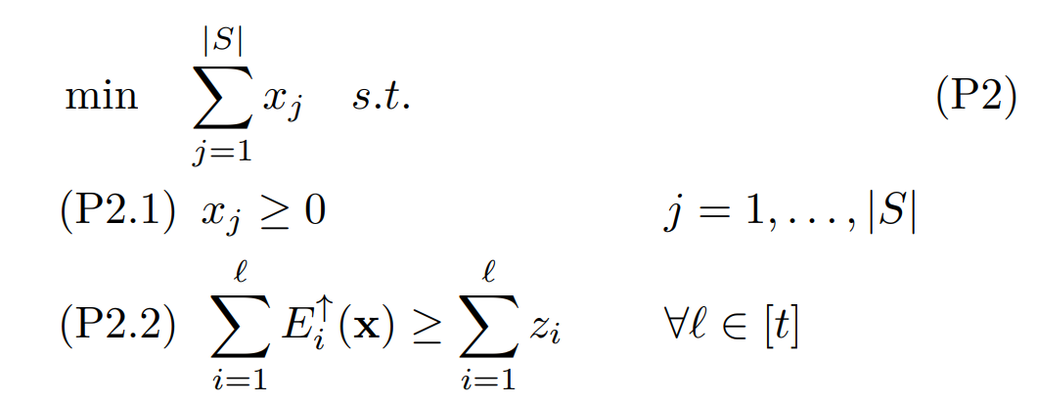
An $α$-Weak Feasibility-Oracle for P1
Approx
Opt-Solver for P2
$$⇒$$
Weak Feasibility-Oracle for P1
Lemma 7.1
$\frac{1}{α}$ -Approx-Optimal Solver for P2 $⇒$ $α$-Weak Feasibility-Oracle for P1
P2 is derived from P1 and a candidate objective-value $z_{t}$ :
Remove the objective function
Add a constraint to ensure that the objective $≥z_{t}$
Remove Constraint (P1.1)
Add new obj: min the sum over $x_{j}$
Notes:
Intuition: P2 try to find the minimum sum with which we can achieve $z_{t}$

Slide 47
An $α$-Weak Feasibility-Oracle for P1
Approx
Opt-Solver for P2
$$⇒$$
Weak Feasibility-Oracle for P1
Lemma 7.1
$\frac{1}{α}$ -Approx-Optimal Solver for P2 $⇒$ $α$-Weak Feasibility-Oracle for P1
$α$-Weak Feasibility-Oracle for P1
Given $\frac{1}{α}$ -Approx. solution to P2, $x^{A}$:
If its objective value $≤1$:
Assert that $z_{t}$ is feasible, return $x^{A}$.
Otherwise:
Assert that $z_{t}$ is infeasible
for solutions using $≤α$ probability.
Weak Feasibility-Oracle for P1
Given $z_{t}∈ℝ_{≥0}^{ }$ returns one of:
Feasible objective
Infeasible objective for sol. using $≤α$ prob.
Notes:
Intuition: P2 try to find the minimum sum with which we can achieve $z_{t}$

Slide 48
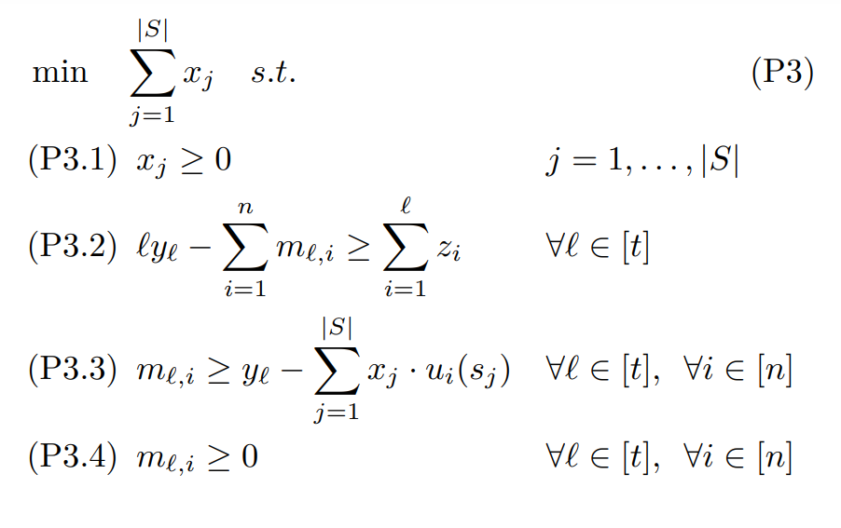
An $\frac{1}{α}$-Approx-Optimal Solver for P2
Approx
Opt-Solver for linear P3
$$⇒$$
Approx
Opt-Solver for P2
Lemma 8.1
$\frac{1}{α}$ -Approx-Optimal Solver for linear P3 $⇒$ $\frac{1}{α}$ -Approx-Optimal Solver for P2
A Linear Program which is Equivalent to P2:
$x^{A}$ is a solution for P2 $⇔$ it is part of a solution for P3
Auxiliary variables are used to “linearize” the constraints
(technique based on Ogryczak and Sliwinski)
P3 Cannot be solved directly: exp. number of variables.
On Direct Methods for Lexicographic Min-Max Optimization. Ogryczak and Sliwinski, 2006.

Slide 49
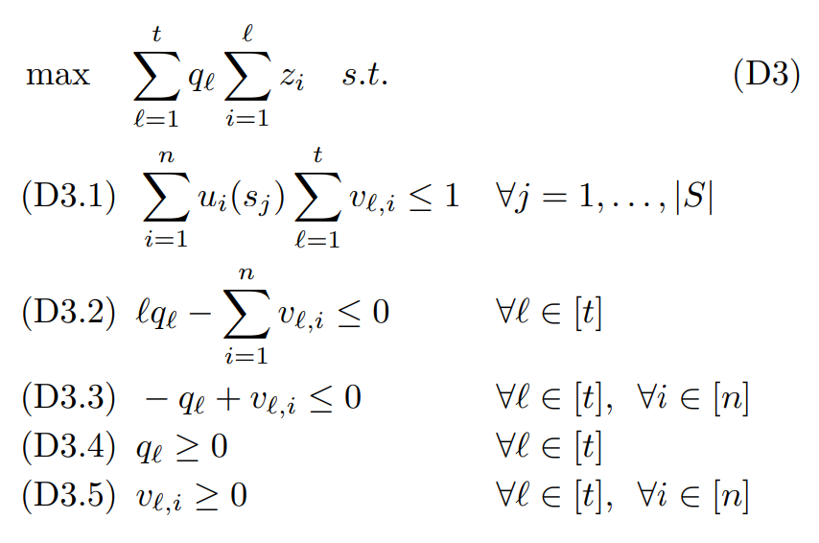
An $\frac{1}{α}$-Approx-Optimal Solver for P3
Approx
Black-Box
for Utilitarian
$$⇒$$
Approx
Opt-Solver for linear P3
Corollary 9.1 + Lemma 10.1
$α$-Black-box for Utilitarian $⇒$ $\frac{1}{α}$ -Approx-Optimal Solver for P3
$$≥$$
Dual
We approximate P3 with its Dual Program and a variant of the ellipsoid method (for approx)
The utilitarian solver is used inside the (approx) separation oracle for the Dual.
An efficient approximation scheme for the one-dimensional bin-packing problem. Karmarkar, and Karp, 1982.

Slide 50
An $\frac{1}{α}$-Approx-Optimal Solver for P3
Approx
Black-Box
for Utilitarian
$$⇒$$
Approx
Opt-Solver for linear P3
Corollary 9.1 + Lemma 10.1
$α$-Black-box for Utilitarian $⇒$ $\frac{1}{α}$ -Approx-Optimal Solver for P3
$$c_{i}$$
Dual
We approximate P3 with its Dual Program and a variant of the ellipsoid method (for approx)
The utilitarian solver is used inside the (approx) separation oracle for the Dual.
An efficient approximation scheme for the one-dimensional bin-packing problem. Karmarkar, and Karp, 1982.

Slide 51
Reduction Flow
Ordered Outcome Alg.
Leximin
Approx
$$⇒$$
Shallow Solver for P1
Ellipsoid Variant on P3 & D3
Approx-Separation-Oracle for D3
Approx Solver
for linear P3
Approx Solver for P2
Weak Feasibility-Oracle for P1
$$⇒$$
$$⇒$$
$$⇒$$
Approx
Black-Box
for Utilitarian
$$⇒$$
Shallow Solver for P1
$$+$$
Approx
Black-Box
for Utilitarian
Approx
Black-Box
for Utilitarian

Slide 52
Reduction Flow
Leximin
Approx
Approx
Black-Box
for Utilitarian

Slide 53
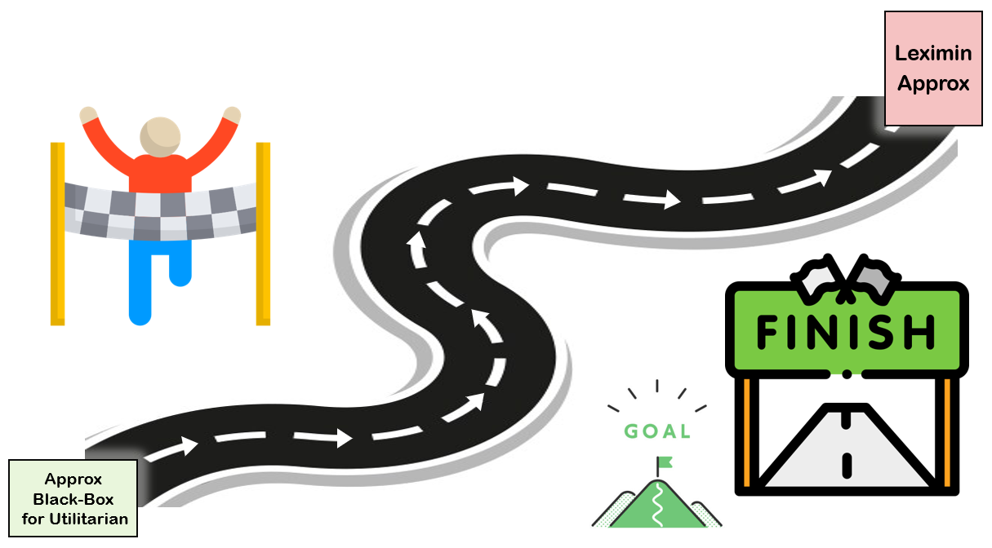
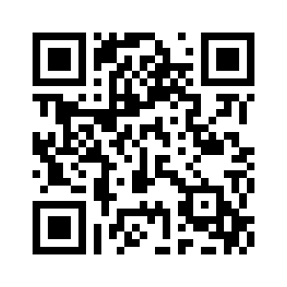
Open Questions
Social choice problems with utilities $≤0$ (e.g. fair allocation of chores, facility location)
Nash welfare objective = Maximize the product of utilities.
Sweet-spot between utilitarian and egalitarian.
Often as hard as egalitarian.
Is there an analogous reduction for Nash welfare?
Best of both worlds: Can we guarantee any ex-post fairness?
Please contact us for any question and any answer!
• erelsgl@gmail.com • eden.r.hartman@gmail.com

